Slide 1
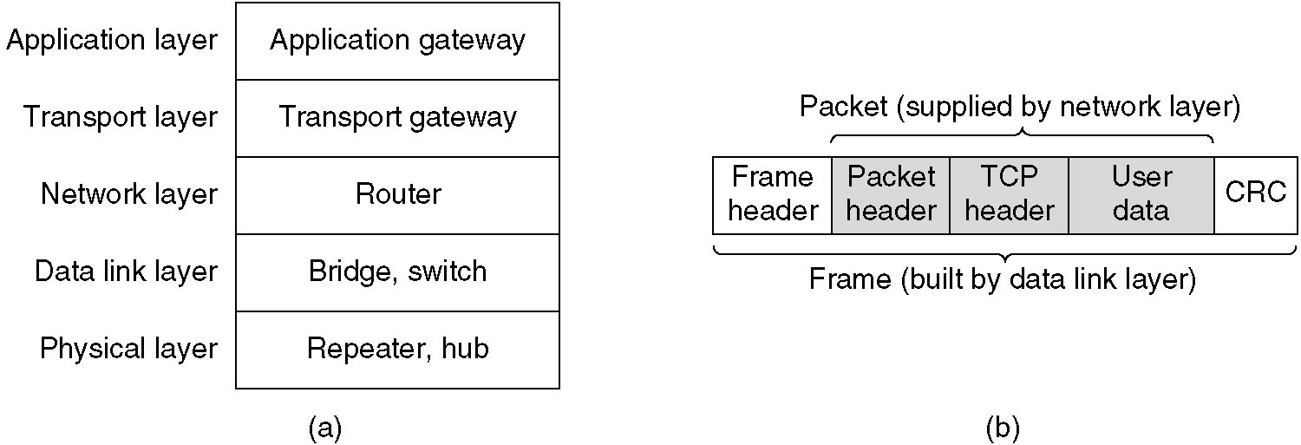
Repeaters, Hubs, Bridges, Switches, Routers and Gateways
(a) Which device is in which layer.
(b) Frames, packets, and headers.

Slide 2
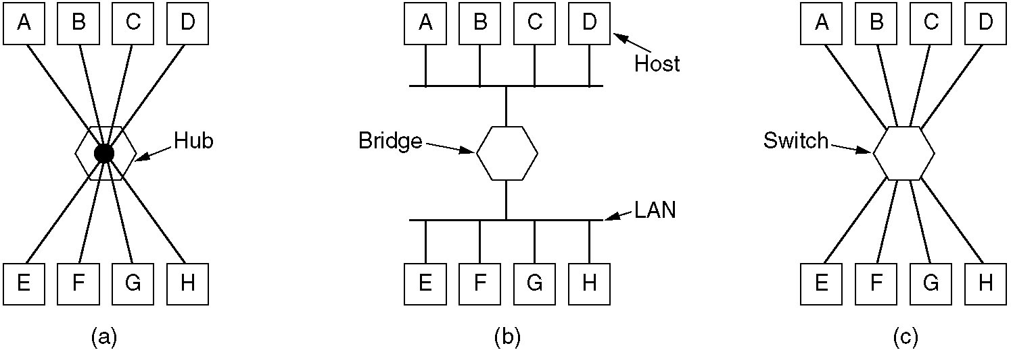
Repeaters, Hubs, Bridges, Switches, Routers and Gateways
(a) A hub. (b) A bridge. (c) a switch.

Slide 3
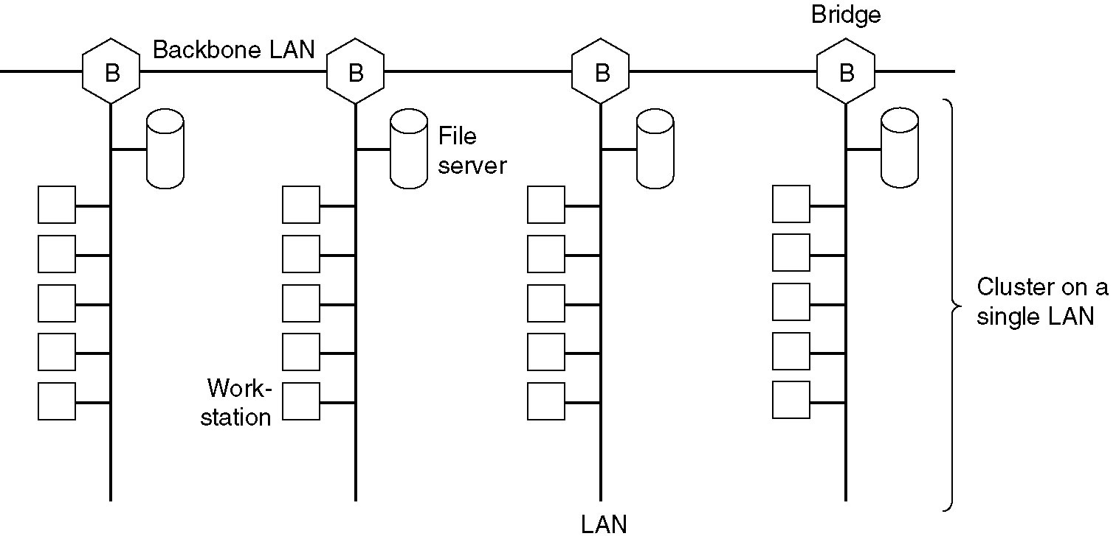
Multiple LAN Bridge Example
Multiple LANs connected by a backbone to handle a total load higher than the capacity of a single LAN.

Slide 4
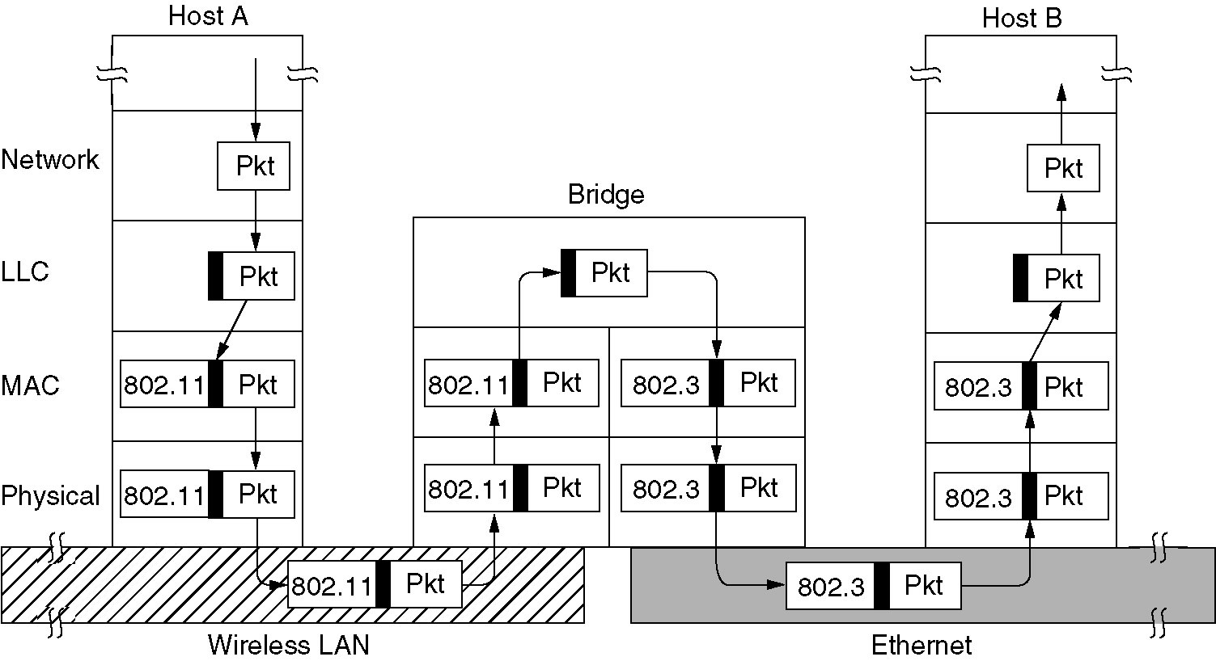
Bridges from 802.x to 802.y
Example of a LAN bridge from 802.11 to 802.3

